Slide 1
Figures exported to Latex

Slide 2

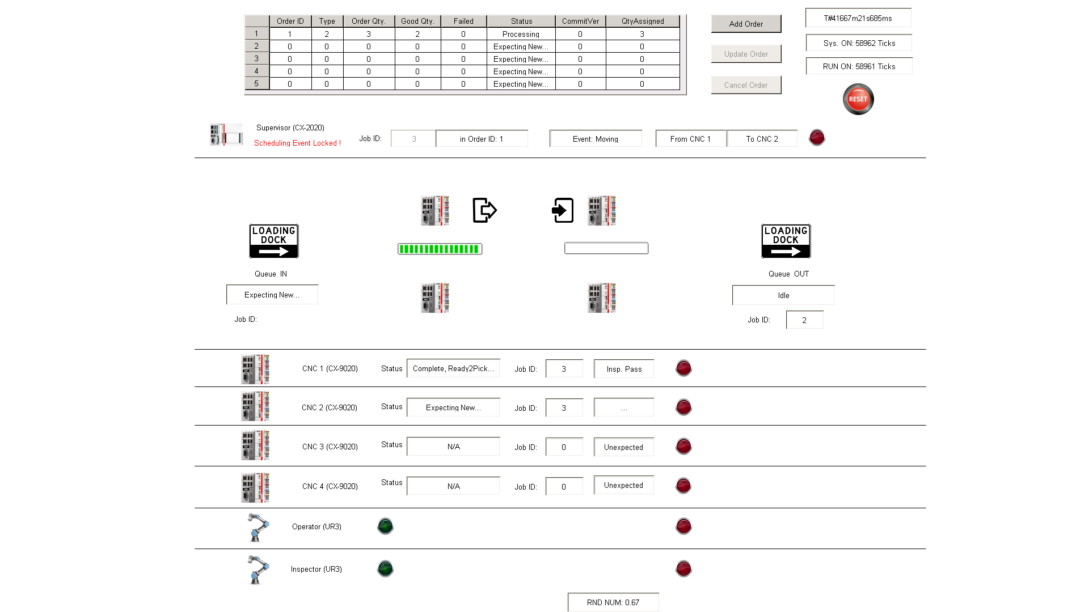
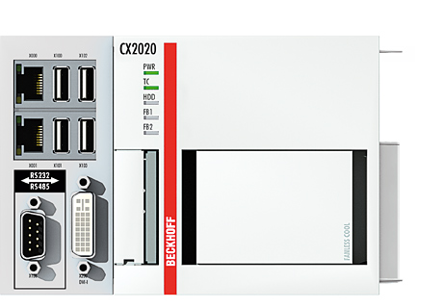

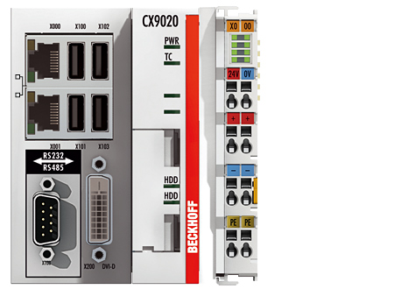

Visualization
HMI
VisuRules()
Supervisor
Order-Based
Human worker
Order_main()
gvOrder
gvSys
gvSch
SCHDL_main()
I/O
Queue_main()
gvQueue
Queue
CNC_1_main()
arrCNC[1]
gvCNC
SCHDL_Sub_Queue()
CNC_2_main()
arrCNC[2]
ADS
Job-Based
CNC_3_main()
arrCNC[3]
SCHDL_Sub_CNC()
Machines
CNC_4_main()
arrCNC[4]
Modbus
UR_OPT_main()
gvUR1
UR_INS_main()
gvUR2
SCHDL_Sub_INS()
Robots
Interfaces
Variable Lists
Scheduler
Notes:
Supervisor code is maintained at the project’s GitLab repo:
https://gitlab.nist.gov/gitlab/el-wireless/el-iws-workcell/tree/plcFeature/PLC/TwinCAT_Emulator_Server

Slide 3
Visualization
HMI
VisuRules()
Supervisor
Order-Based
Human worker
Order_main()
gvOrder
gvSys
gvSch
SCHDL_main()
I/O
Queue_main()
gvQueue
Queue
CNC_1_main()
arrCNC[1]
gvCNC
SCHDL_Sub_Queue()
CNC_2_main()
arrCNC[2]
ADS
Job-Based
CNC_3_main()
arrCNC[3]
SCHDL_Sub_CNC()
Machines
CNC_4_main()
arrCNC[4]
Modbus
UR_OPT_main()
gvUR1
UR_INS_main()
gvUR2
SCHDL_Sub_INS()
Robots
Interfaces
Variable Lists
Scheduler
Notes:
Supervisor code is maintained at the project’s GitLab repo:
https://gitlab.nist.gov/gitlab/el-wireless/el-iws-workcell/tree/plcFeature/PLC/TwinCAT_Emulator_Server

Slide 4
Visualization
HMI
VisuRules()
Supervisor
Order-Based
Human worker
Order_main()
gvOrder
gvSys
gvSch
SCHDL_main()
I/O
Queue_main()
gvQueue
Queue
CNC_1_main()
arrCNC[1]
gvCNC
SCHDL_Sub_Queue()
CNC_2_main()
arrCNC[2]
ADS
Job-Based
CNC_3_main()
arrCNC[3]
SCHDL_Sub_CNC()
Machines
CNC_4_main()
arrCNC[4]
Modbus
UR_OPT_main()
gvUR1
UR_INS_main()
gvUR2
SCHDL_Sub_INS()
Robots
Interfaces
Variable Lists
Scheduler
Notes:
Supervisor code is maintained at the project’s GitLab repo:
https://gitlab.nist.gov/gitlab/el-wireless/el-iws-workcell/tree/plcFeature/PLC/TwinCAT_Emulator_Server

Slide 5
Visualization
HMI
VisuRules()
Supervisor
Order-Based
Order_main()
gvOrder
gvSys
gvSch
SCHDL_main()
I/O
Queue_main()
gvQueue
CNC_1_main()
arrCNC[1]
gvCNC
SCHDL_Sub_Queue()
CNC_2_main()
arrCNC[2]
ADS
Job-Based
CNC_3_main()
arrCNC[3]
SCHDL_Sub_CNC()
CNC_4_main()
arrCNC[4]
Modbus
UR_OPT_main()
gvUR1
UR_INS_main()
gvUR2
SCHDL_Sub_INS()
Interfaces
Variable Lists
Scheduler
Notes:
Supervisor code is maintained at the project’s GitLab repo:
https://gitlab.nist.gov/gitlab/el-wireless/el-iws-workcell/tree/plcFeature/PLC/TwinCAT_Emulator_Server

Slide 6
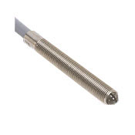
CNC Emulator
gvSys
ADS
gvSta
STA_main()
Supervisor
gvComm
COMM_main()
IOI_main_IN()
I/O
gvIoi
IOI_main_OUT()
Proximity sensor
gvDiag
DIAG_main()
Variable Lists
Function Modules
Notes:
CNC Emulator
In the architecture, functions are grouped by their roles: processing, communication, I/O, and diagnostics.
Emulator code is maintained at the project’s GitLab repo:
https://gitlab.nist.gov/gitlab/el-wireless/el-iws-workcell/tree/plcFeature/PLC/TwinCAT_Emulator_CNC

Slide 7
CNC Emulator
gvSys
ADS
gvSta
STA_main()
Supervisor
gvComm
COMM_main()
IOI_main_IN()
I/O
gvIoi
IOI_main_OUT()
Proximity sensor
gvDiag
DIAG_main()
Variable Lists
Function Modules
Notes:
CNC Emulator
In the architecture, functions are grouped by their roles: processing, communication, I/O, and diagnostics.
Emulator code is maintained at the project’s GitLab repo:
https://gitlab.nist.gov/gitlab/el-wireless/el-iws-workcell/tree/plcFeature/PLC/TwinCAT_Emulator_CNC

Slide 8
CNC Emulator
gvSys
ADS
gvSta
STA_main()
gvComm
COMM_main()
IOI_main_IN()
I/O
gvIoi
IOI_main_OUT()
gvDiag
DIAG_main()
Variable Lists
Function Modules
Notes:
CNC Emulator
In the architecture, functions are grouped by their roles: processing, communication, I/O, and diagnostics.
Emulator code is maintained at the project’s GitLab repo:
https://gitlab.nist.gov/gitlab/el-wireless/el-iws-workcell/tree/plcFeature/PLC/TwinCAT_Emulator_CNC

Slide 9
Supervisor
CNC x
CNC y
Inspector
Operator
StaRprt: UR Ready
StaRprt: Complete@x
StaRprt: Empty@y
StaRprt: UR Ready
IF Sys. Unlocked THEN
SCHDL: Move x to y;
Sys. Locked;
Move route: x -> y
New Job Info.
Expect New
Part Arrival
StaRprt: UR Ready
Robot_OUT
Sys. Unlocked;
…
Job Start
Job at one CNC machine
Inspect. Ready
Inspect. Req. @ y
IF Sys. Unlocked THEN
SCHDL: Inspect @ y;
Sys. Locked;
Inspect. @ y
Inspect. Done @ y
Inspect. Rsp
Job Complete
StaRprt: Complete@y
StaRprt: UR Ready
Time
Sys. Unlocked
…
Notes:
Key is gvSch.bMoveLocked for safety (at any moment, at most one job is moving between machines by one robot)
The inspection request has a higher priority at the scheduler and any inspection request should be queued in case the system is locked when the request arrives.

Slide 10
Para. Init. Done
No Err.
INIT_0
INIT_1
INIT_2
Sys. ON
Start
Part Departure
EMPTY
EXPECT
NEW
NEW JOB IN
PREP.
RUN
COOL.
INSPCT
COMPL
New
JobInfo.
Part
Arrival
Robot OUT
Prep. TIMEOUT
RUN TIMEOUT
COOL. TIMEOUT
INSPCT
RSP received
RESET
PLC_RESET (ADS)

Slide 11
INIT_0
Para. Init. Done
INIT_1
No Err.
INIT_2
Sys. ON
Start
Part Departure
EMPTY
EXPECT
NEW
NEW JOB IN
New
JobInfo.
Part
Arrival
COMPL
RESET
Robot OUT
PREP.
RUN
COOL.
INSPCT
INSPCT
RSP received
PLC_RESET (ADS)
Prep. TIMEOUT
RUN TIMEOUT
COOL. TIMEOUT

Slide 12
INIT
IDLE/
EMPTY
New JobInfo.
BUSY
Sys. ON
Start
Part Departure
INIT_0
Para. Init. Done
INIT_1
No Err.
INIT_2
EXPECT
NEW
Part Arrival
NEW JOB IN
Robot OUT
PREP.
Prep. TIMEOUT
RESET
INSPCT
RSP Received
RUN TIMEOUT
RUN
COMPL
INSPCT
COOL. TIMEOUT
COOL.
PLC_RESET
(Ext. ADS Interrupt, Anytime)

Slide 13
INIT
IDLE/
EMPTY
New Job Information
BUSY
System ON
Start
Part Departure
INIT_0
Parameter Initialized
INIT_1
No Error
INIT_2
EXPECT
NEW
Part Arrival
NEW JOB IN
Robot OUT
IN
PREPARA
-TION
Prep. TIMEOUT
RESET
INSPECTION
RESPONSE Received
RUN TIMEOUT
RUN
INSPEC-TION
COOL. TIMEOUT
PLC_RESET
(External ADS Interrupt, Anytime)
COMPLETE
COOLING

Slide 14
INIT
IDLE/
EMPTY
New Job Assigned
BUSY
System ON
Start
Part Departure
INIT_0
Parameters Initialized
INIT_1
No Error
INIT_2
Part Arrival
Robot OUT
IN PREPARA
-TION
EXPECT NEW
PART
LOADED
Preparation Timeout
RESET
RUN
INSPECTION
RESPONSE Received
PLC_RESET
(External ADS Interrupt, Anytime)
Cooling
Timeout
COMPLETE
INSPEC
-TION
COOLING
RUN Timeout

Slide 15
IN QUEUE
*
SUBMIT
IN CHANGE
*
*
EXPECT NEW
+
CANCL.
+
+
IN PROC
COM -PLETE
Order
HMI
Job Good ++
/Job Failed ++
PLC
Job Assigned ++
Queue
EXPECT
NEW
EMPTY/IDLE
EMPTY
/IDLE
COM-PLETE
COM
-PLETE
EXPECT
NEW
Queue_IN
Queue_OUT
To CNCs
From CNCs
INIT_0
INIT_1
INIT_2
Notes:
State machines in the order and queue modules

Slide 16
IN QUEUE
*
IN CHANGE
*
*
EXPECT NEW
SUBMITTED
+
+
+
CANCELLED
IN PROCESS
Order
COMPLETE
HMI
Job Good ++
/Job Failed ++
PLC
Job Assigned ++
Queue
EXPECT
NEW
EMPTY/IDLE
EMPTY
/IDLE
COMPLETE
COMPLETE
EXPECT
NEW
Queue_IN
Queue_OUT
Part leaving to CNCs
Part coming from CNCs
INIT_0
INIT_1
INIT_2
Notes:
State machines in the order and queue modules

Slide 17
IN QUEUE
*
*
IN CHANGE
*
SUBMITTED
+
EXPECT NEW
+
+
CANCELLED
IN PROCESS
Order
COMPLETE
HMI
Job Good ++
/Job Failed ++
PLC
Job Assigned ++
Queue
EXPECT NEW
EMPTY
/IDLE
EMPTY
/IDLE
COMPLETE
Queue_IN
COMPLETE
Queue_OUT
EXPECT NEW
Part leaving to CNCs
Part coming from CNCs
INIT_0
INIT_1
INIT_2
Notes:
State machines in the order and queue modules

Slide 18
IN QUEUE
SUBMITTED
*
IN CHANGE
*
EXPECT NEW
*
+
CANCELLED
+
IN PROCESS
+
COMPLETE
HMI
Order
Job Good ++
/Job Failed ++
Job Assigned ++
PLC
Queue
EXPECT NEW
EMPTY
/IDLE
EMPTY
/IDLE
COMPLETE
Queue_IN
COMPLETE
EXPECT NEW
Queue_OUT
Part leaving to CNCs
Part coming from CNCs
INIT_0
INIT_1
INIT_2
Notes:
State machines in the order and queue modules

Slide 19
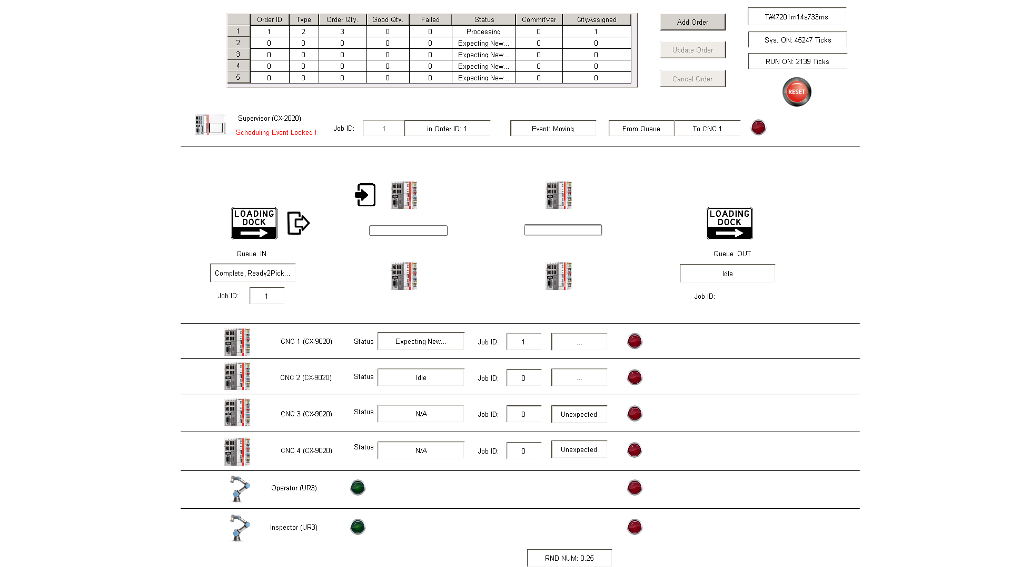
Online Order Editor
Sys. Info.
Scheduler Info.
Process Illustration
Machine Status Dashboard

Slide 20
Online Order Editor
System Timing & Reset
Scheduler Info.
Process Illustration
Machine Status Dashboard

Slide 21
UR3 NO Error
AND bStart = TRUE
New_Job
bReady = FALSE
INIT_0
UR3@Start
INIT_1
IDLE
MOVE
Reboot
Job_Done
bReady = TRUE
bReset = TRUE

Slide 22
PLC
(Supervisor)
CNC X
Operator
/Inspector
Scheduler
Interface
CNC_x
Queue
Interface UR3
NORMAL
NORMAL
NORMAL
NORMAL
NORMAL
Reboot
NORMAL
PLC_Reset & Start
INIT_0
INIT_0
INIT_0
INIT_0
UR3_Reset
INIT_0
bReset = TRUE
bReady = TRUE
(End of Current move)
Time
INIT_0
Notes:
Key is gvSch.bMoveLocked for safety (at any moment, at most one job is moving between machines by one robot)
The inspection request has a higher priority at the scheduler and any inspection request should be queued in case the system is locked when the request arrives.

Slide 23
PLC
(Supervisor)
CNC X
Operator
/Inspector
Scheduler
Interface
CNC_x
Queue
Interface UR3
NORMAL
NORMAL
NORMAL
NORMAL
NORMAL
Reboot
NORMAL
PLC_Reset & Start
INIT_0
INIT_0
INIT_0
INIT_0
UR3_Reset
INIT_0
End of active move
Time
INIT_0
Notes:
Key is gvSch.bMoveLocked for safety (at any moment, at most one job is moving between machines by one robot)
The inspection request has a higher priority at the scheduler and any inspection request should be queued in case the system is locked when the request arrives.

Slide 24
PLC
(Supervisor)
CNC X
Operator
/Inspector
Scheduler
Interface
CNC_x
Interface UR3
Queue
NORMAL
NORMAL
NORMAL
NORMAL
NORMAL
Reboot
NORMAL
PLC_Reset
INIT_0
INIT_0
INIT_0
INIT_0
UR3_Reset
INIT_0
End of active move
Time
INIT_0
Notes:
Key is gvSch.bMoveLocked for safety (at any moment, at most one job is moving between machines by one robot)
The inspection request has a higher priority at the scheduler and any inspection request should be queued in case the system is locked when the request arrives.

Slide 25
CNC X (PLC)
INIT_0
PLC (Supervisor)
UR3
(OPT)
Interface INIT:
RESET parameters and remote modules (if applicable)
Scheduler
Intrf. CNC_X
Queue
Intrf. UR
Order
Power ON
INIT_1
PLC_Reset & Start
Logic INIT:
CHECK any logic errors and fix them online (if applicable)
INIT_0
INIT_0
INIT_0
INIT_0
PLC_Reset & Start
INIT_0
INIT_0
INIT_0
Interface: INIT_1
INIT_2
INIT_1@X: NO Err
Clean INIT:
CONFIRM the ready to start status
INIT_1
INIT_1
INIT_1
INIT_1
INIT_1@UR: NO Err
IF Err, stay in INIT_1
INIT_1
NO Errors
INIT_1
INIT_1
INIT
Opt. Start
Event triggered state switch
Opt. Start
INIT_2
INIT_2
Sufficient state switch condition
INIT_2
INIT_2
INIT_2
INIT_2
INIT_2
Status: EMPTY
STATE_EMPTY
EXPECT_NEW
READY@UR, NO Err
Necessary state switch condition
UR_READY
EXPECT_NEW
SYS READY (Passive State)
SYS READY (Passive State)
SYS READY (Active State)
Time
SYS READY
SYS READY
SYS READY
SYS READY
Coordinated state switch between submodules
NORMAL
Notes:
Key is gvSch.bMoveLocked for safety (at any moment, at most one job is moving between machines by one robot)
The inspection request has a higher priority at the scheduler and any inspection request should be queued in case the system is locked when the request arrives.

Slide 26
Supervisor
CNC X
Intrf. CNC_X
Intrf. UR3
Operator
/Inspector
Scheduler
Queue
Order
Power ON
PLC_Reset & Start
INIT_0
INIT_0
INIT_0
INIT_0
PLC_Reset & Start
INIT_0
INIT_0
INIT_0
Interface: INIT_1
INIT_1@X: NO Err
INIT_1
INIT_1
INIT_1
INIT_1
INIT_1@UR: NO Err
IF Err, stay in INIT_1
INIT_1
NO Errors
INIT_1
INIT_1
INIT
Opt. Start
Opt. Start
INIT_2
INIT_2
INIT_2
INIT_2
INIT_2
INIT_2
INIT_2
Status: EMPTY
STATE_EMPTY
EXPECT_NEW
READY@UR, NO Err
UR_READY
EXPECT_NEW
SYS READY
SYS READY
Time
SYS READY
SYS READY
SYS READY
SYS READY
SYS READY
NORMAL
Notes:
Key is gvSch.bMoveLocked for safety (at any moment, at most one job is moving between machines by one robot)
The inspection request has a higher priority at the scheduler and any inspection request should be queued in case the system is locked when the request arrives.

Slide 27

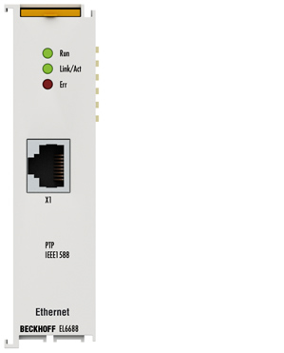
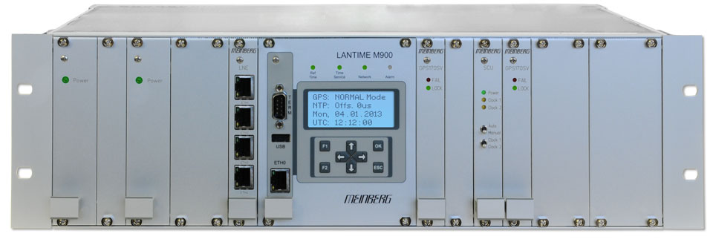

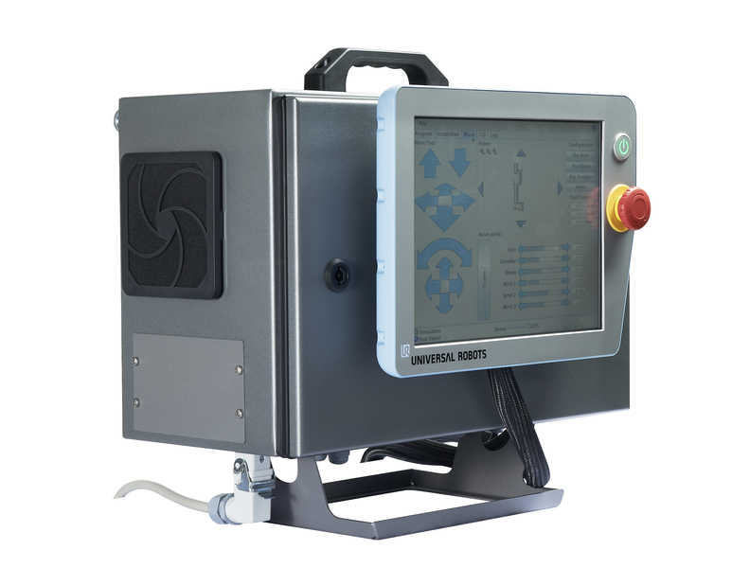

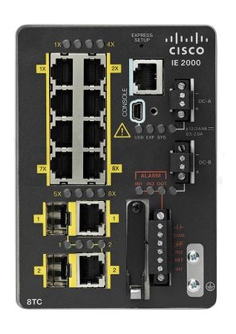
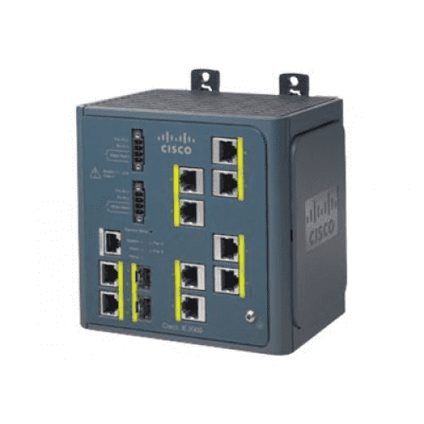
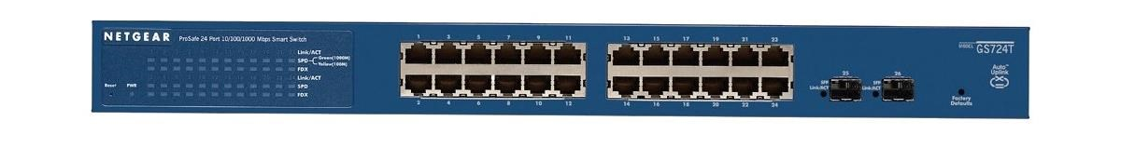
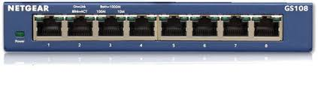


INS_F/T
Compute box
UR3 (INS)
Control box
NTP Sync
PLC
PLC 1588 Term
Grandmaster (GM)
10.10.0.51
PTP Sync
Supervisor
TSN Switch
Cisco IE-3000-8tc
Cisco IE-2000-8tc
Main Switch (24 ports)
Netgear GS9724Tv4
LinuxPTP
Netgear GS108
UR3 RTDE
Port mirroring
(Ingress & Egress)
CNC_1
CNC_2
Data Collector
OPT_F/T
Compute box
UR3 (OPT)
Control box
CNC_3
Wireshark
CNC_4
Notes:
Baseline network connections:
Production data (Green), measurement data (Red), and PTP synchronization (Purple)

Slide 28
INS_F/T
Compute box
UR3 (INS)
Control box
NTP Sync
PLC
PLC 1588 Term
Grandmaster (GM)
PTP Sync
Supervisor
TSN Switch
Cisco IE-3000-8tc
Cisco IE-2000-8tc
Main Switch (24 ports)
Netgear GS9724Tv4
LinuxPTP
Netgear GS108
Port mirroring
(Ingress & Egress)
UR3 RTDE
CNC_1
CNC_2
Data Collector
Wireshark
OPT_F/T
Compute box
UR3 (OPT)
Control box
CNC_3
CNC_4
Production Subnet
Measurement Subnet
Notes:
Baseline network connections:
Production data (Green), measurement data (Red), and PTP synchronization (Purple)

Slide 29


PLC_1 CX-9020
(Modbus Master/Client)
10.10.0.6
Wireshark
PLC CX-2020
(Modbus Slave/Server)
10.10.0.5
Lab Network
nTAP
(10.10.0.6 <-> 10.10.0.5)
App. (Modbus)
App. (Modbus)
NIC (Ether.)
NIC (TAP)
NIC (Ether.)
MB_READ/WRITE.bBusy = TRUE
Modbus TCP Query (Read/Write Multiple Registers)
App. Delay (RTT)
Transmission Delay (RTT)
MB_READ/WRITE.bBusy = FALSE
Modbus TCP Response
Time
Modbus TCP ACK
Notes:
App. Delay

Slide 30
PLC_1 CX-9020
(Modbus Master/Client)
10.10.0.6
Wireshark
PLC CX-2020
(Modbus Slave/Server)
10.10.0.5
Lab Network
nTAP
(10.10.0.6 <-> 10.10.0.5)
App. (Modbus)
App. (Modbus)
NIC (Ether.)
NIC (TAP)
NIC (Ether.)
MB_READ/WRITE.bBusy = TRUE
Modbus TCP Query (Read/Write Multiple Registers)
App. Delay (RTT)
Transmission Delay (RTT)
MB_READ/WRITE.bBusy = FALSE
Modbus TCP Response
Time
Modbus TCP ACK
Notes:
App. Delay

Slide 31
Network analyzer
Lab Network
PLC
(Supervisor)
TAP
UR3
(Operator
/Inspector)
TAP
One-way link delay
Modbus Request (Read/Write)
Processing delay
Link RTT
Application
Round-trip time (RTT)
Time
Modbus Response

Slide 32
Network analyzer
UR3
(Operator
/Inspector)
PLC
(Supervisor)
TAP
TAP
Lab Network
One-way link delay
Modbus Request (Read/Write)
Link RTT
Application
Round-trip time (RTT)
Process
-ing delay
Modbus Response
Time

Slide 33
Wireshark
Slave
Master
Modbus Request (Read/Write)
PLC
(Supervisor)
UR3
(Operator
/Inspector)
Modbus Response
Lab Network

Slide 34
Slave
Master
Modbus_Read
Return Register(s)
PLC
(Supervisor)
Modbus_Write
UR3
(Operator)

Slide 35
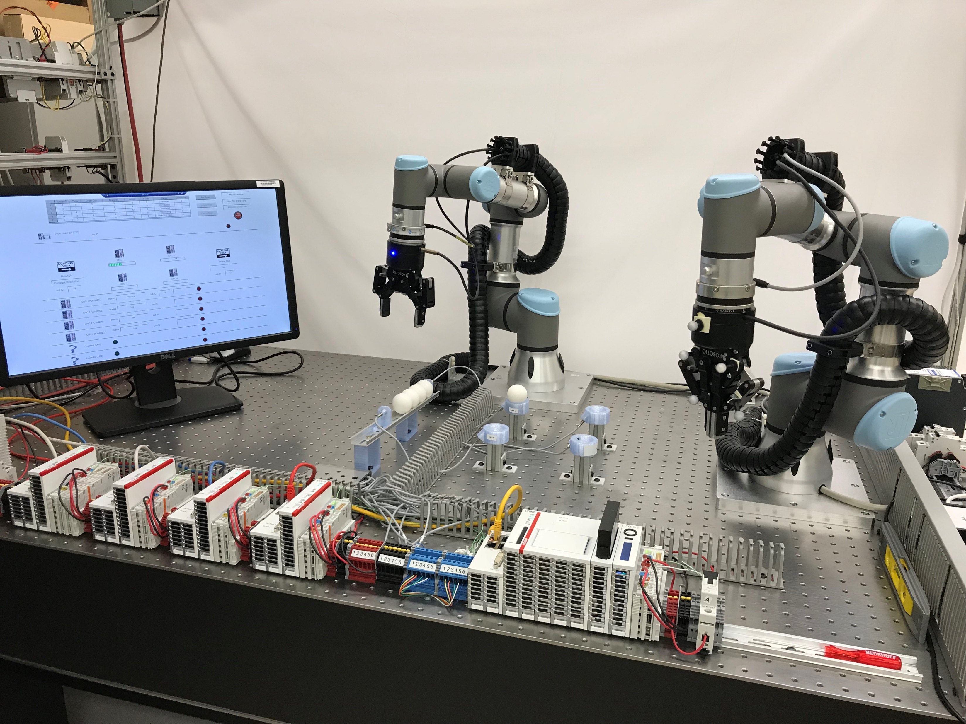
Robots
HMI
Queue
Tooling machines
Supervisor

Slide 36

Robots
HMI
Queue
Tooling machines
Supervisor

